Slide 1
P_hacking
and replication crisis
19
Probability
and
Statistics
COMS10011
Dr. Anne Roudaut
csxar@bristol.ac.uk
https://github.com/coms10011

Slide 2
ego depletion story

Slide 3
1998
ROY Baumeister
do people have a limited
amount of will power?

Slide 4
1998
so he conducted a study …
the results show that humans do have a limited pool of self-control
once we have had to resist temptation it is a lot harder to di it again

Slide 5
1998
they called this
Ego Depletion::
has had huge influence on psychological research, been incorporated into dieting tactics, training techniques, and even adverting used today
ads telling how we deserve a product, causing mental fatigue and frustration, leading us to buy
but today it seems that this phenomenon does not exist at all

Slide 6
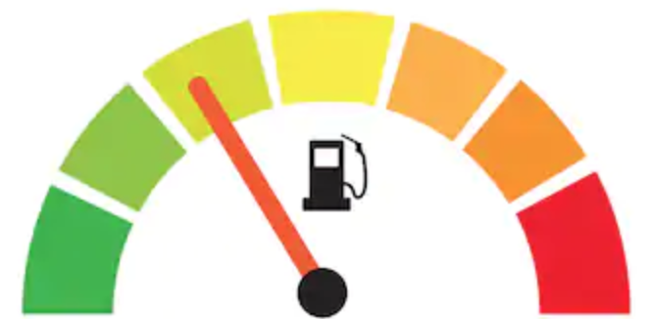
1998
ROY Baumeister’s hypothesis:
self-control is a limited resource, and it takes energy and motivation to maintain restraint
every time use your self-control, your draw on that strength and it takes some time for you to recover it

Slide 7
1998
ROY Baumeister’s task:
two act of self-control back-to-back

Slide 8
1998
cooked delicious cookies and invited 67 students with empty stomach to sit in the baking room

Slide 9
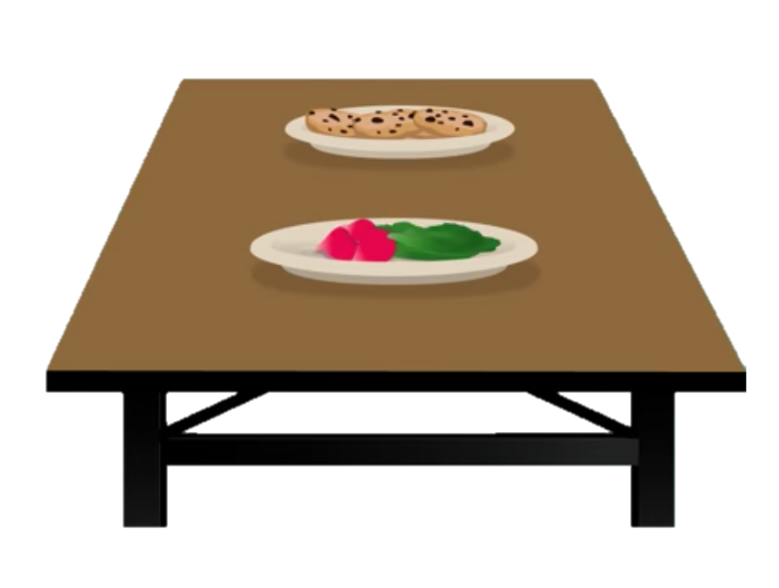
1998
5 min
alone
half the students told to eat the cookies
half the students the radishes

Slide 10

1998
checked how long it tool to give up
then asked to solve a difficult (in fact impossible) puzzle

Slide 11
1998
would resisting the cookies make it harder for participants to keep trying?
those who ate radishes = 8 minutes of trying
those who ate cookies = 19 minutes of trying
<brainstorming: could you already see something wrong with their studies?>

Slide 12
1998
confounding variable::
eating cookies (high in sugar) could be the reason of the longer effort provided

Slide 13
1998
would resisting the cookies make it harder for participants to keep trying?
those who ate radishes = 8 minutes of trying
those who ate cookies = 19 minutes of trying
3rd group with no cookies encounter = 21 minutes
and of course all these comparison with p<0.05 = strong evidences for ego depletion (who later became a subfield of psychology with many more studies done to confirm it)

Slide 14
2007
in 2007, researchers figured out what seemed to be happening biologically:
as people used up their self-control, their blood sugar levels were dropping
they made subjects watching emotional videos without showing emotions / while others did not have to hold back

Slide 15
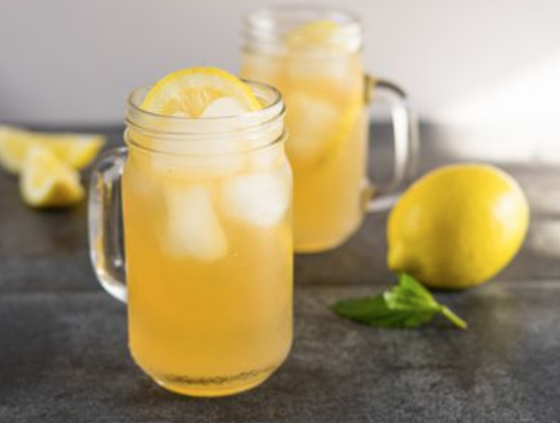
2007
subjects who used willpower = lower blood glucose, and when they replenished that glucose it restored their self-control

Slide 16
2010
evidences even more in 2010 when group of researchers led by Martin Hagger, examined 83 published studies on ego depletion to conclude that effect was real

Slide 17
2012
but in 2012 researchers casted some doubts
e.g. subjects did not have to drink lemonade to replenish their will power, tasting it was enough
e.g. subjects who believe in willpower could affect their performance

Slide 18
2014
in 2014, researchers tried to replicate the original studies and could not find the effect
they also looked at the meta analysis of 2010 (the 83 papers) and found a lot of issues, e.g. they re run the analysis with newer methods … and the ego depletion effect disappeared
this started a wave a concern about replicability hitting the field of psychology

Slide 19
2016
in 2016, the Association for Psychological Science opened a Registered Replication Report on ego depletion:
one official experiment would be conducted by researchers in many different labs
Baumeister (original study) even helped design the experiment and Martin Hagger (led of the meta analysis) lead the project
A Multilab Preregistered Replication of the Ego-Depletion Effect

Slide 20
2016
on 24 labs (different language and culture)
only 2 found the effect
and 1 group found the opposite effect

Slide 21
what does it mean?
could argue that it is just this particular task where ego depletion does not show up but that willpower is still a limited resource
or may be ego depletion only happens under very specific circumstances … if at all

Slide 22
this has created a lot of movements in the scientific community and a lot of researches is working on it to find ways to better analyze and report studies

Slide 23
replication crisis
p hacking
p crisis

Slide 24

(veritasium channel)
Notes:
6:22

Slide 25
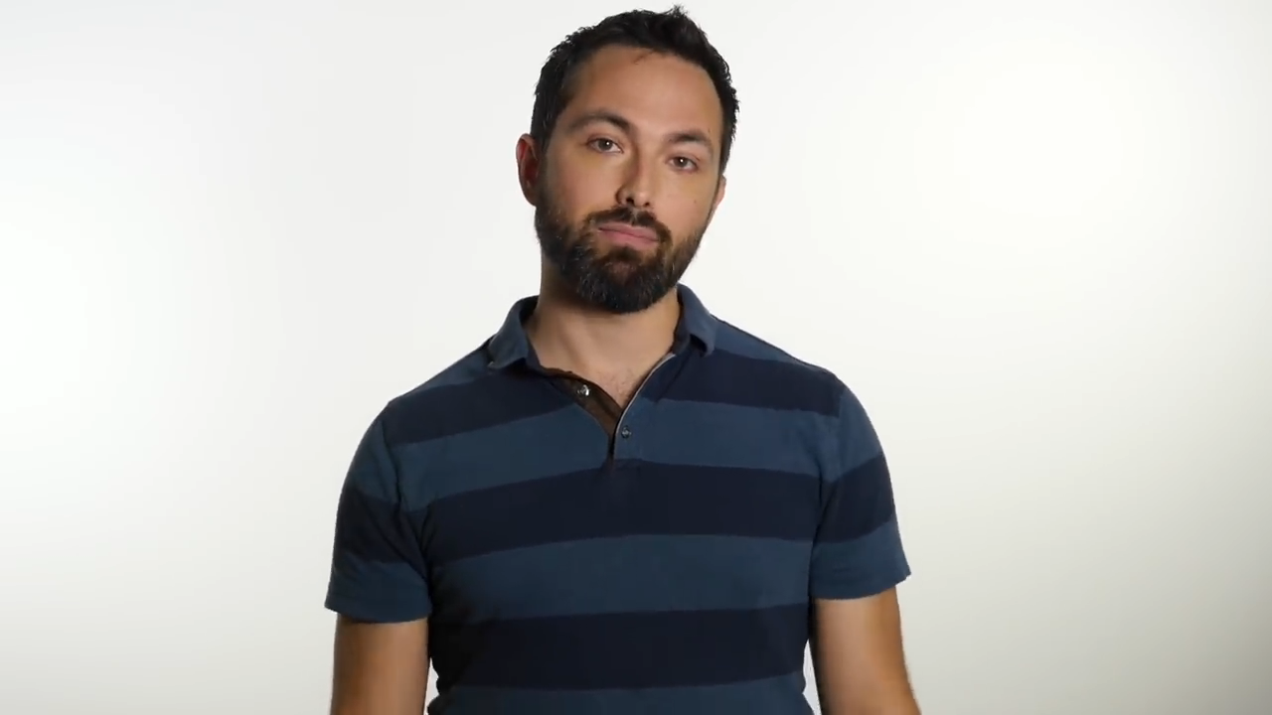
(veritasium channel)
Notes:
2 minute 16

Slide 26
mmm does it mean that all I have learned in this lecture is wrong?
no fortunately there are a many things you can do to analyse stats and report data correctly as well as minimise these problems …

Slide 27
good statistics

Slide 28
1
design a study properly and don’t go fishing!

Slide 29
fishing = gathering as many data as you can, then try to find something statistically significant in it and report it = NO
rather have clear hypothesis to start with (remember one hypothesis = logical sentence that can be directly tested) and just test for your hypothesis

Slide 30
1
5
research question / hypothesis?
look at raw data
2
6
in(dependant) variables?
look at distributions
3a
within or between subjects?
7a
check for normality
3b
counterbalancing?
7b
run some stats
4
8
how many repetitions/trials?
conclude

Slide 31
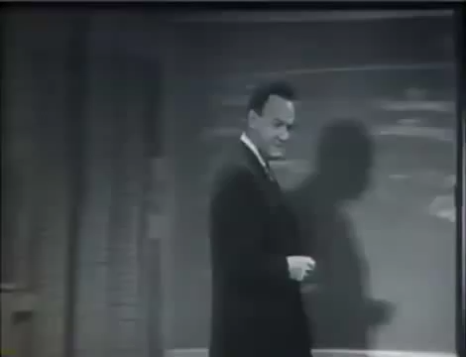
Richard Feynman (1964)

Slide 32
you could also decide to pre-register your study (more and more frequent in scientific venues)

Slide 33
and of course design your experiment to remove as much noise as possible
i.e. pilot it!

Slide 34
2
increase sample size or better compute the required sample size
pvalue
0.05
so that statistical
power >80%
sample size

Slide 35
3
report p value with effect size
e.g. a new hair loss shampoo is statistically better than existing shampoo
but does not say that subjects who took it only grew 5 hairs more than control group …
effect size matters more!

Slide 36
4
report confident intervals and non misleading grap
confident intervals::
a 95% confidence interval is a range of values that you can be 95% certain contains the true mean of the population
a range of plausible values for the mean (values outside relatively implausible)

Slide 37
R
# first we run the one-way anova
library(Rmisc)
tgc <- summarySE(dat, measurevar="score", groupvars=c("group"))
tgc
group N score sd se ci
1 A 20 6.60 1.1424811 0.2554665 0.5346976
2 B 20 7.25 1.1180340 0.2500000 0.5232560
3 C 20 1.95 0.8255779 0.1846048 0.3863824
ggplot(data = tgc, aes(x = tgc$group, y = tgc$score)) + geom_bar(stat = 'identity', position = 'dodge') + geom_errorbar(aes(ymin= tgc$score - ci, ymax= tgc$score + ci), width=.2, position=position_dodge(.9))
Notes:
head(cars) # cars is a table that already comes with R and contain 50 observations of speed and distance in two rows
scatter.smooth(x=cars$speed, y=cars$dist, main="Dist ~ Speed") # scatterplot
linearMod <- lm(dist ~ speed, data=cars) # build linear regression model on full data
summary(linearMod) # summary(linearMod)$r.squared
abline(linearMod, col="blue")

Slide 38
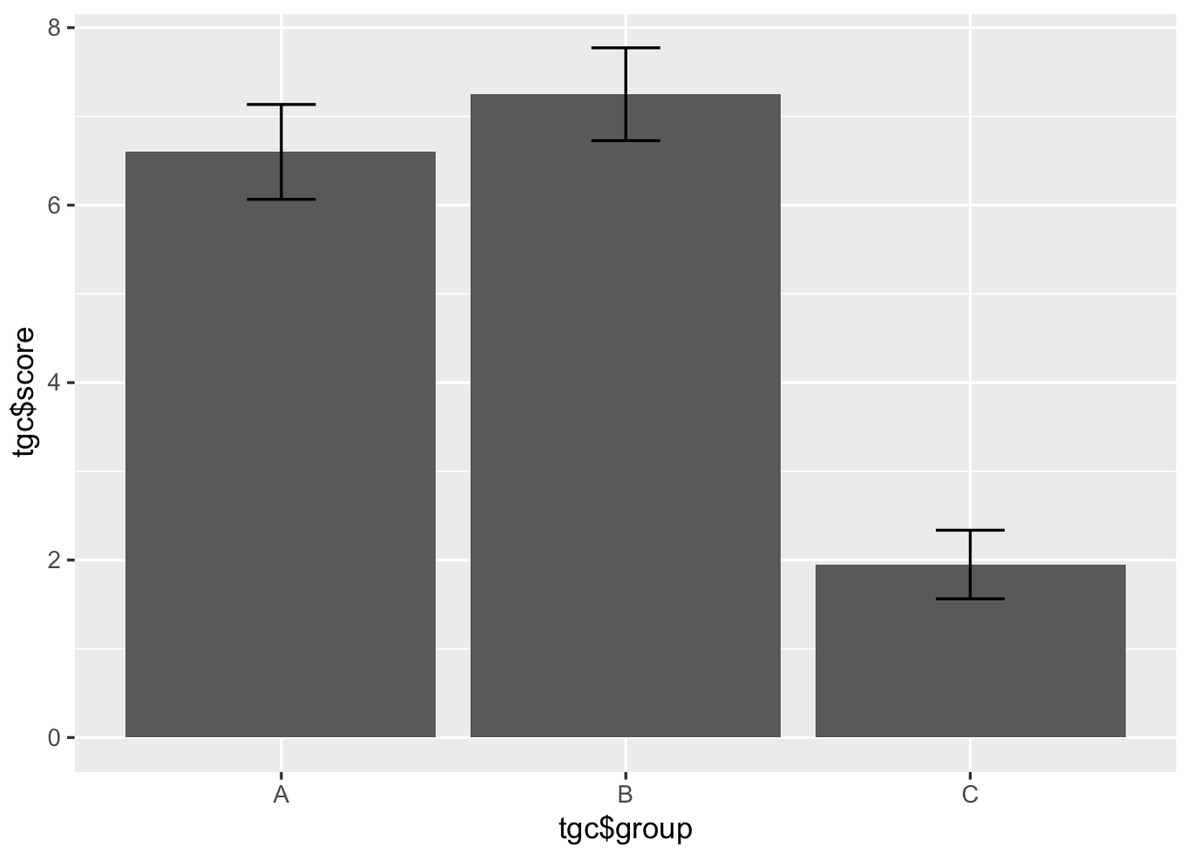

Slide 39
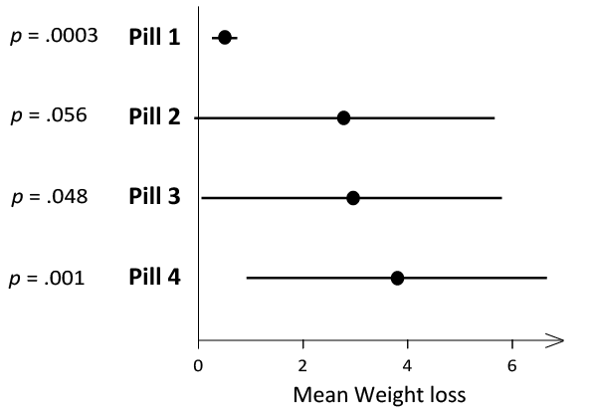
Error bars are 95% CIs
p-values are based on a null hypothesis of no effect
Adapted from (Ziliak and McCloskey, 2009)
which weight-loss pill would you recommend?

Slide 40
Error bars are 95% CIs
p-values are based on a null hypothesis of no effect
Adapted from (Ziliak and McCloskey, 2009)
which weight-loss pill would you recommend?

Slide 41
Error bars are 95% CIs
p-values are based on a null hypothesis of no effect
Adapted from (Ziliak and McCloskey, 2009)
which weight-loss pill would you recommend?

Slide 42
4th
2nd
1st
Error bars are 95% CIs
p-values are based on a null hypothesis of no effect
Adapted from (Ziliak and McCloskey, 2009)
which weight-loss pill would you recommend?

Slide 43
0 kilo lost
4th
2nd
1st
Error bars are 95% CIs
p-values are based on a null hypothesis of no effect
Adapted from (Ziliak and McCloskey, 2009)
which weight-loss pill would you recommend?

Slide 44
“Statistical significance is perhaps the least important attribute of a good experiment; it is never a sufficient condition for claiming that a theory has been usefully corroborated, that a meaningful empirical fact has been established, or that an experimental report ought to be published” (Likken, 1968)
“We have the duty of communicating our conclusions in intelligible form, in recognition of the right of other free minds to utilize them in making their own decisions” (Fisher, 1955)
“no confidence interval should be interpreted as a a significance test” (Schmidt and Hunter, 1997)

Slide 45
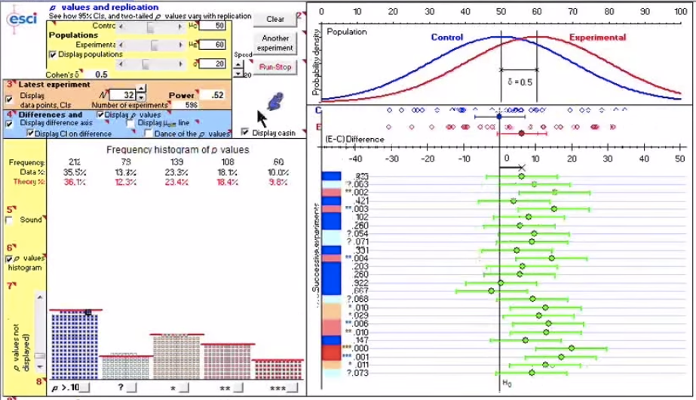
Geoff Cumming’s dance of p-values
https://www.youtube.com/watch?v=ez4DgdurRPg

Slide 46

spot misleading graphs

Slide 47
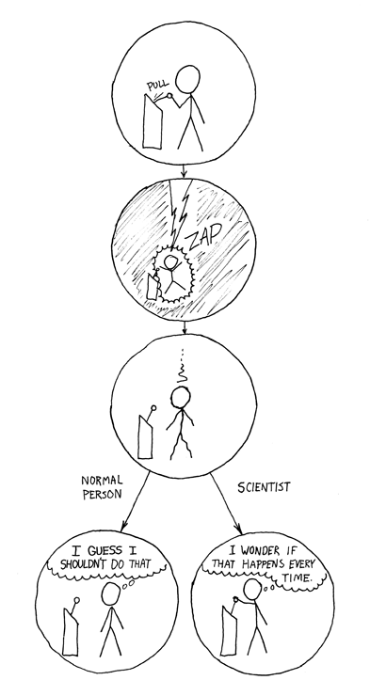
5
replicate!
and fight publication standards,
e.g. in certain fields there are conferences to publish replication studies

Slide 48
6
rather use artificial data
certain tasks are very sensitive to human variability (e.g. ego depletion on will power but also anything that related to preferences)
tasks involving participants but relying on motor skills (e.g. tapping on a key) suffer less from human variability
or use data without involving human (e.g. algorithms comparisons)

Slide 49
7
remember this is an active field, always look up for new statistical methods
e.g. at the moment there is a strong tendency to push for Bayesian testing, although it also has drawbacks
need prior data
simple for AB testing but could become quickly complex
unclear how it compares to pvalue testing
(still some research to do on this so keep your eyes open!)

Slide 50
for the curious: tutorial on GitHub to do a simple comparison of two groups with Bayesian methods

Slide 51
8
be ethical
i.e. moral principles that govern a person's behaviour or the conducting of an activity
why are you doing a study, intrinsically because you want to learn something, not just publishing
of course be also ethical with your study design

Slide 52

research goes wrong (Standford Experiment)
… use ethical boards (in each university)

Slide 53
summary

Slide 54
take away
Explain what is the replication crisis
Give the steps seen in class to avoid phacking and do good statistics
Understand that this is a hot topic of research and know that you need to keep your eye open if you ever encounter stats later in your career

Slide 55
unit menu
Linear regression
Hypothesis testing, comparing things
Experimental design a: T-test
Experimental design b: ANOVA
How T-test and ANOVA work
Non-parametric tests a, normality tests
Non-parametric tests b
Categorical data: Chi-square
Sample size, power and effect size (luluah)
Replication crisis and good stats
Questions before exam

Slide 56
to go further

Slide 57
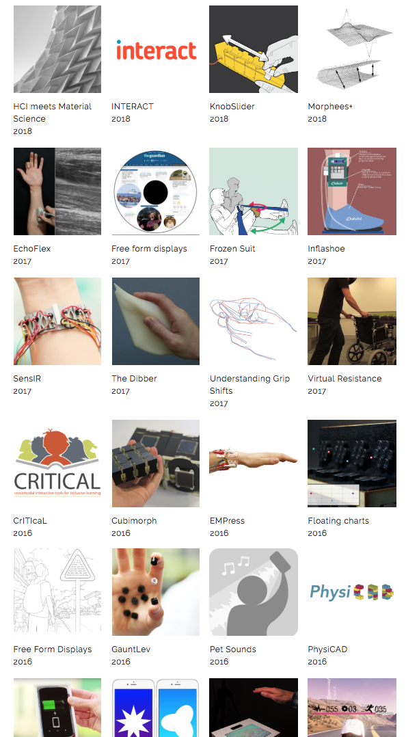

www.biglab.co.uk
BristolIG lab
(Youtube)
example of what we do
https://www.youtube.com/watch?v=liPzZIex54M

Slide 58
I
H
inter-
action
human
C
computer
Notes:
It’s stand for

Slide 59
curriculum
to go further:
year 1: Probability and statistic
year 2: CS and society (with introduction to HCI)
year 3 (currently year 2): HCI
year 4: Interactive Devices (pre-req HCI)

Slide 60
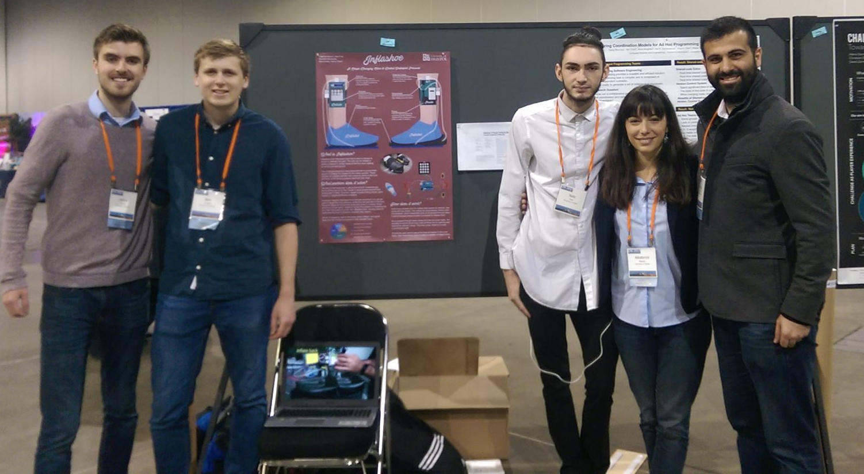
students presenting their inflating shoes at best conference in HCI in Montreal in 2018

Slide 61
end

